Slide 1
“Using Android Devices for Embedded Applications”
Transferring Data Using Audio Signal in Android

Slide 2
Preliminary Research
NXP made a board named quick-jack in 2014 for a similar purpose. It is probably based on a university project Hi-Jack, developed in 2011. A project was reported on Hackaday on this problem statement. Intel also has an article on this problem statement, in which they talk about projects Hi-Jack and Quick-Jack.
Requisite Study
To start with project, you will need to study and get yourself acquainted with a few things:
What are the different type of digital “serial” communication protocols: I2C, UART, SPI etc. Get hands on with them by trying to communicate 2 Arduinos or Raspberry Pis using these communication protocols.
Understand the working of the Audio Jack: how and in what form it transmits the data?
Get hands on with it: go to Electronics lab and test the signal on the audio jack’s terminals using an oscilloscope.
Understand the working of Sound Card, and how its ADC/DAC works. Get hands on: buy some cheap USB sound cards and destroy a few of them.

Slide 3
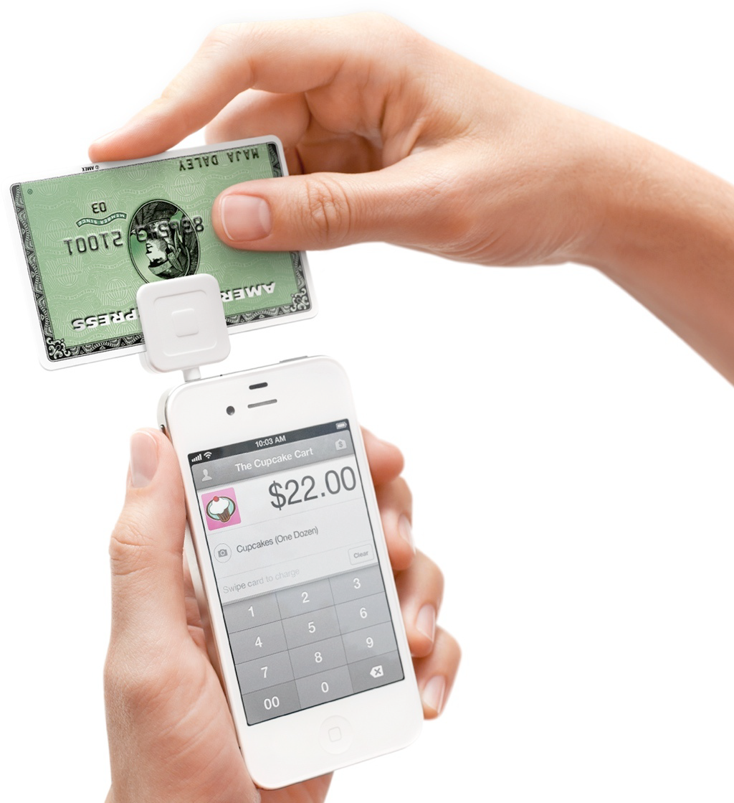
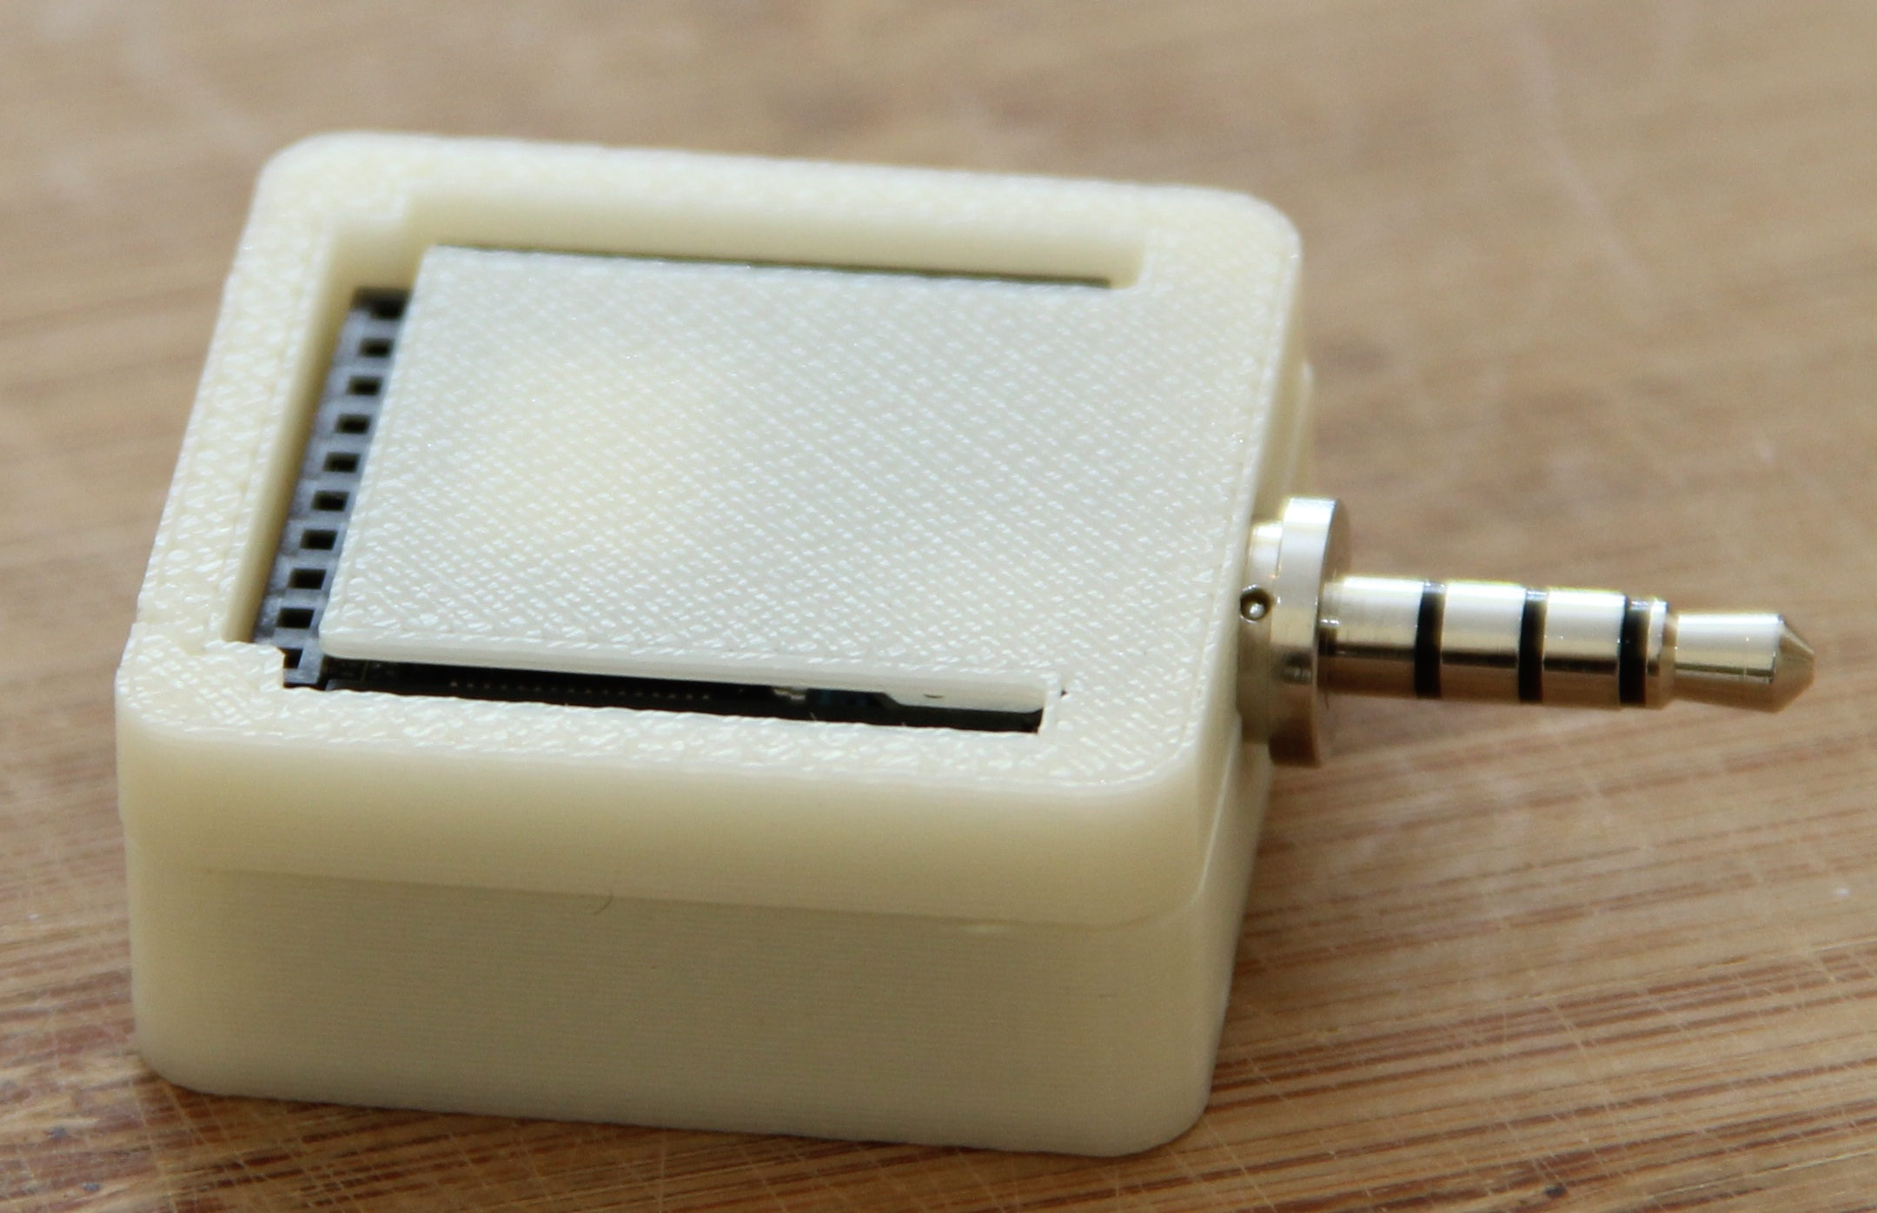
Inspiration!

Slide 4
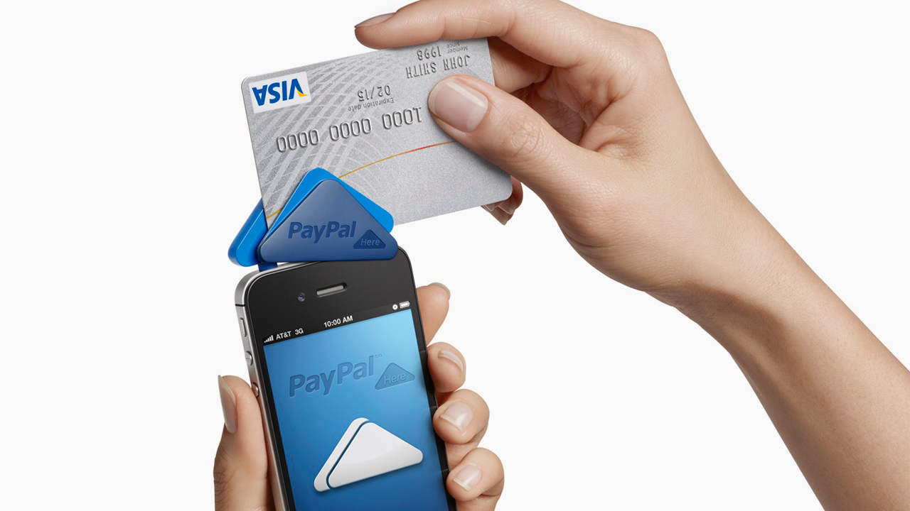

Slide 5
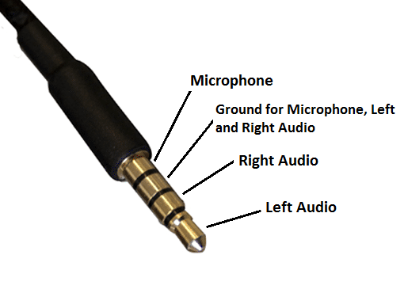
Overview
Build an embedded system that captures, encodes and transmits sensor data.
The theory behind audio encoding/decoding.
Build an Android app that receives, decodes and displays sensor data.

Slide 6
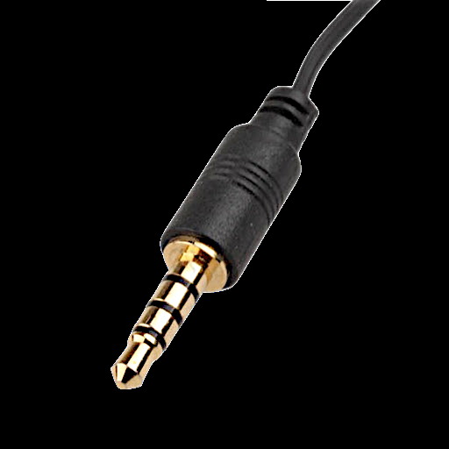
DATA INSIDE AUDIO
Sound/Audio is Analog
Your data is Digital (0 or 1)
Data and Audio are combined using Frequency Shift keying (FSK)
Android has a built in analog to digital Convertor

Slide 7
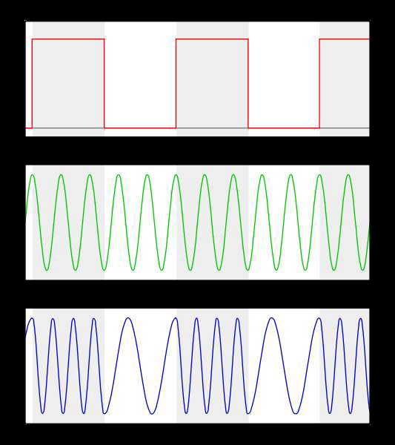
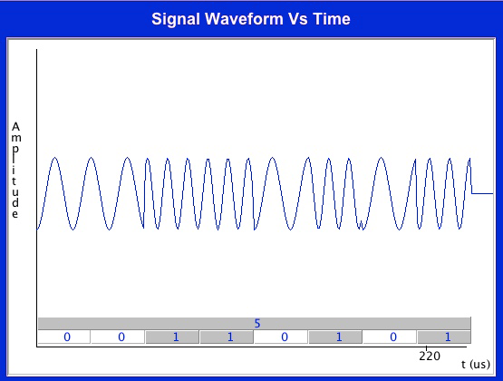
WHAT IS FSK?

Slide 8
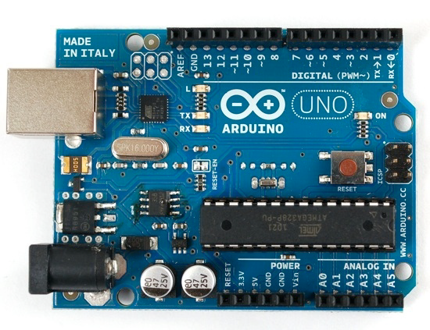
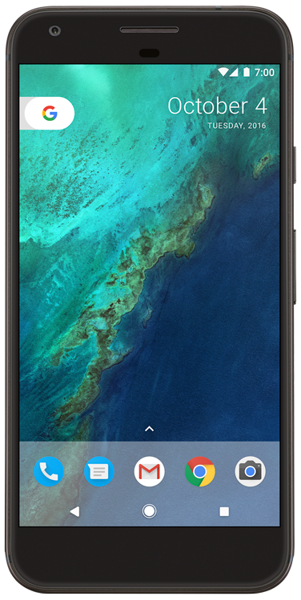
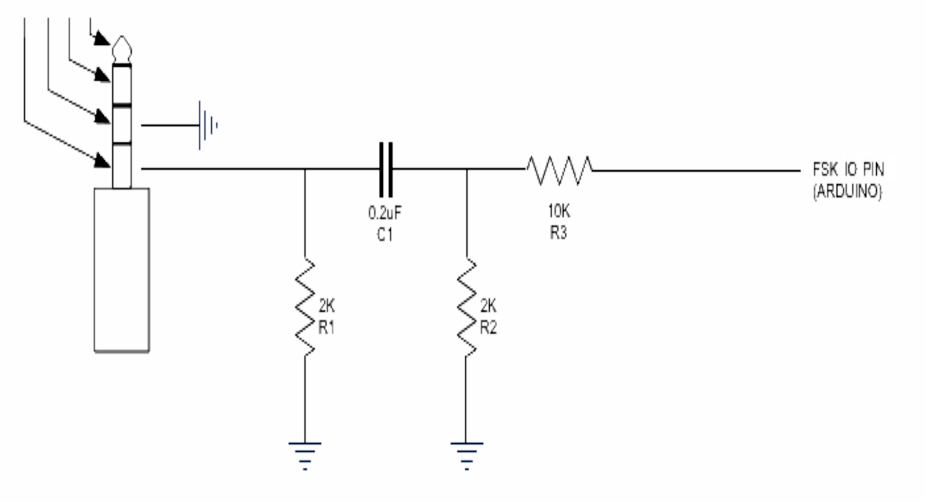
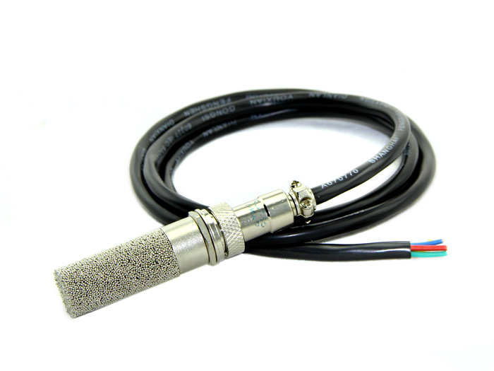
THE CIRCUIT

Slide 9
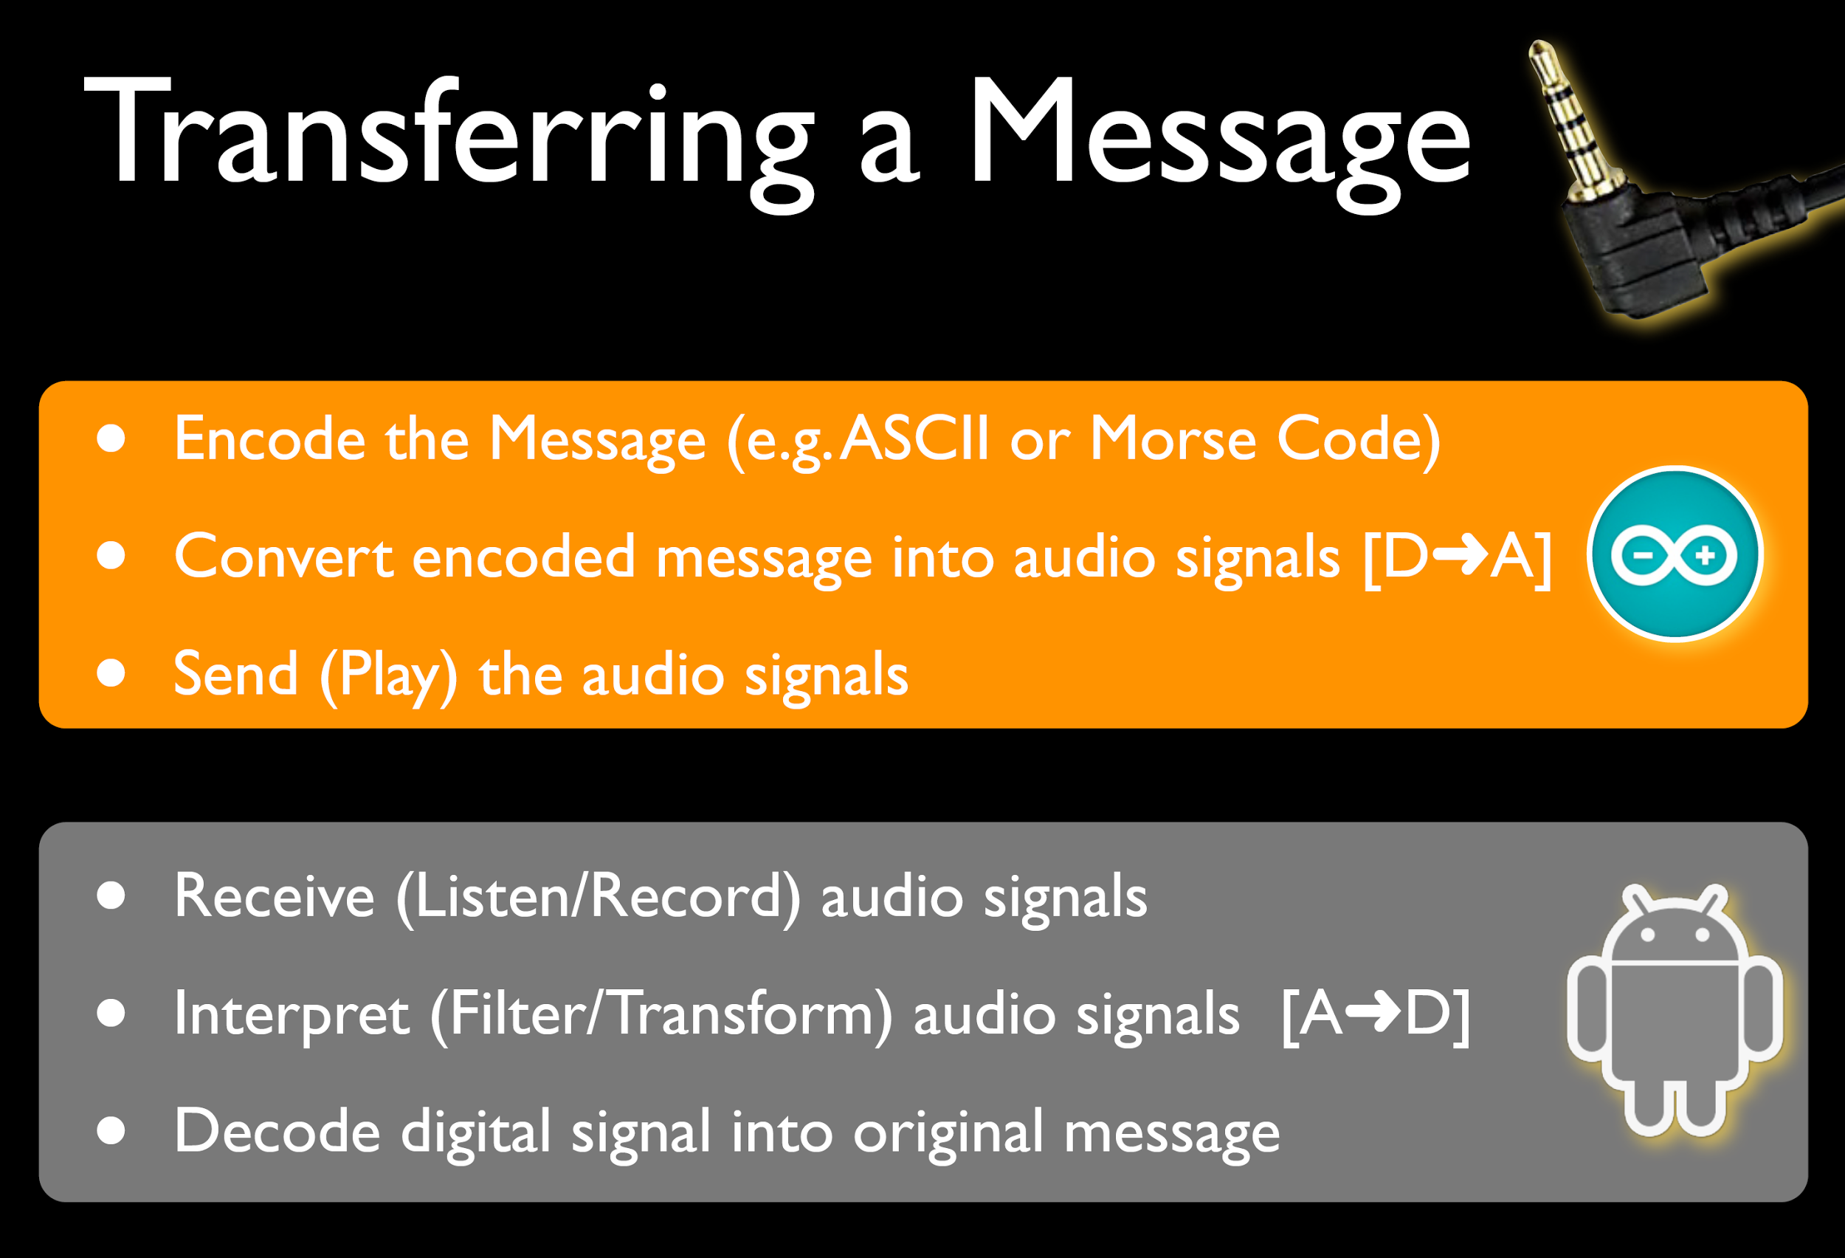

Slide 10
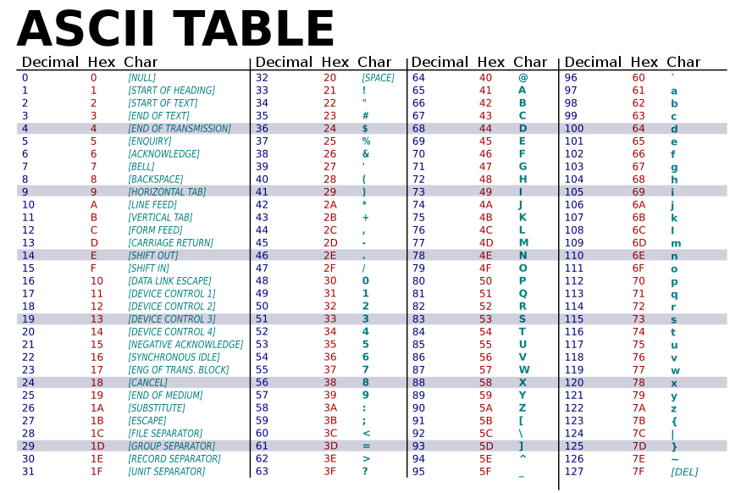

Slide 11
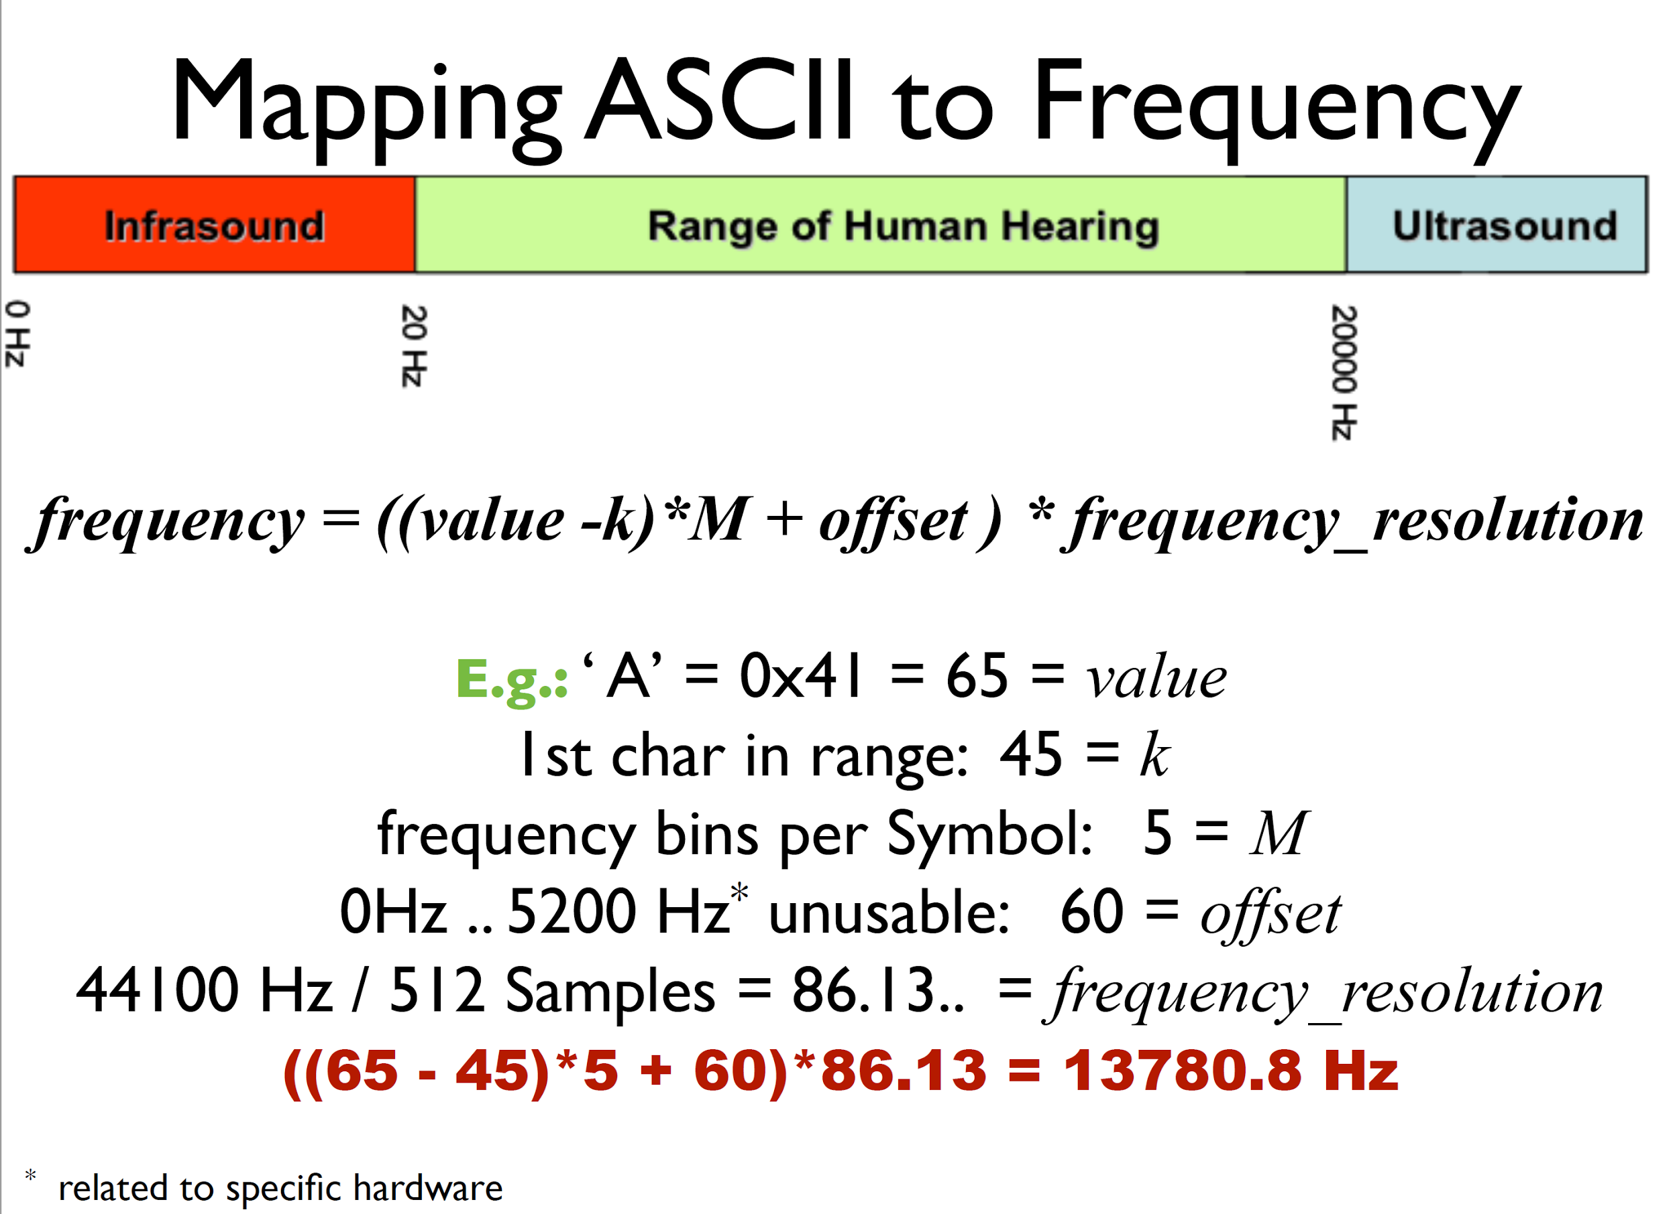

Slide 12
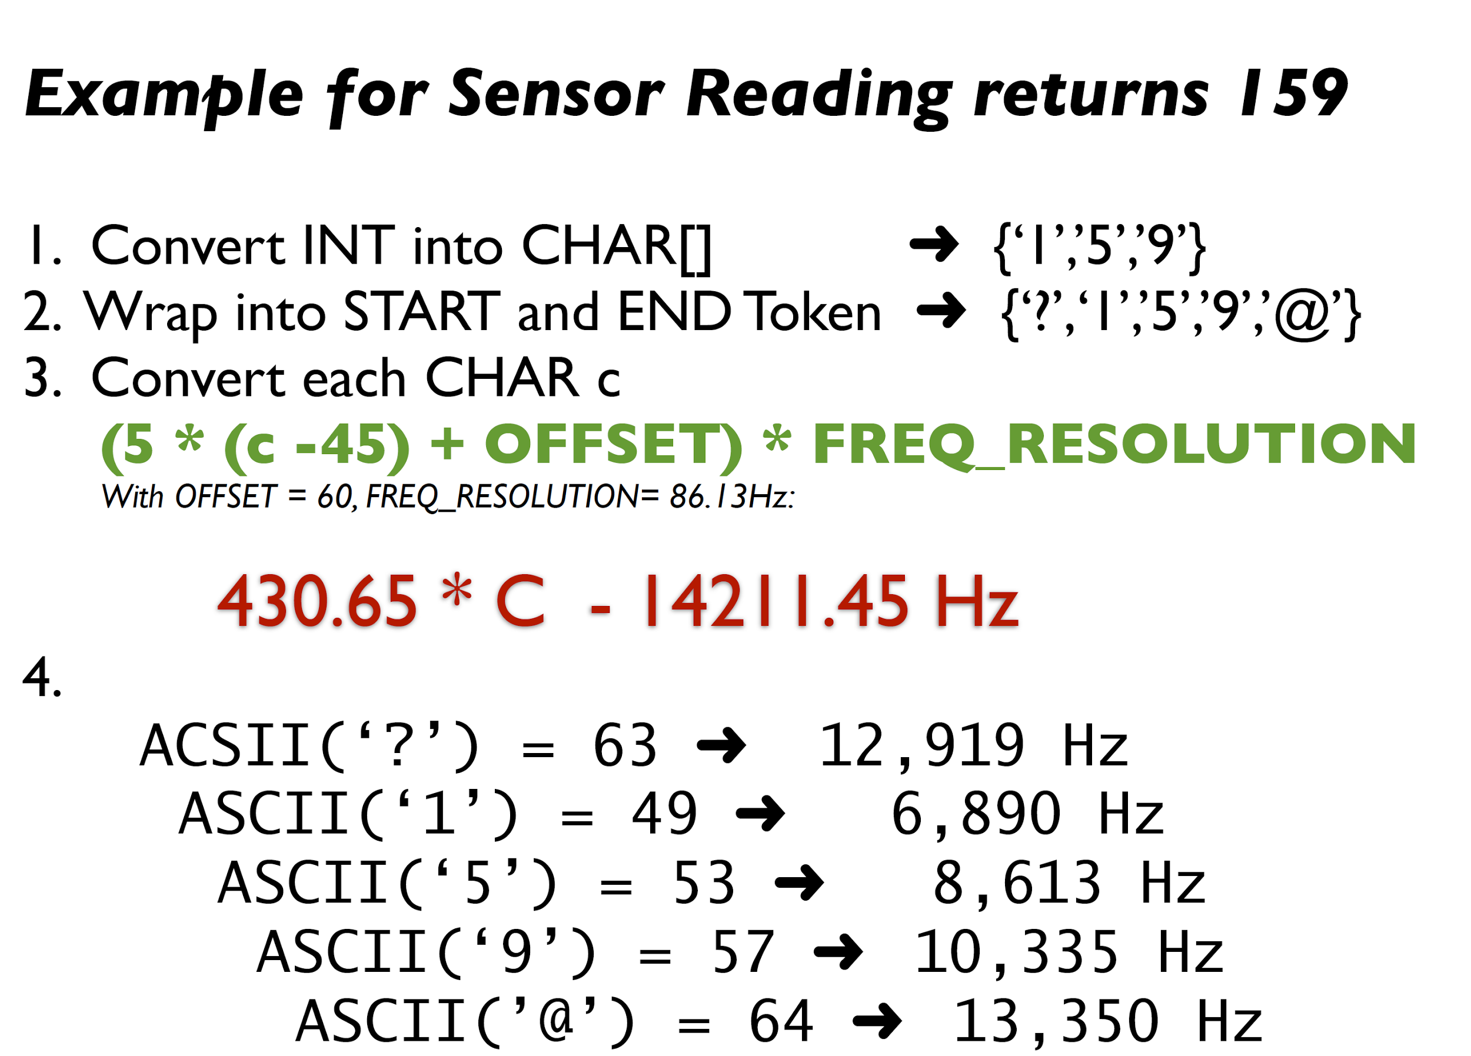

Slide 14
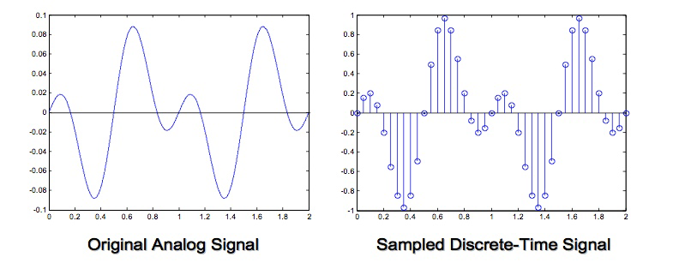

Slide 15
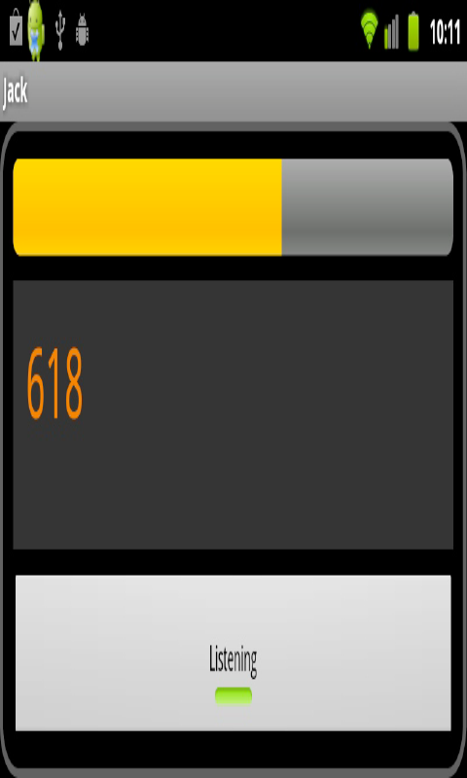
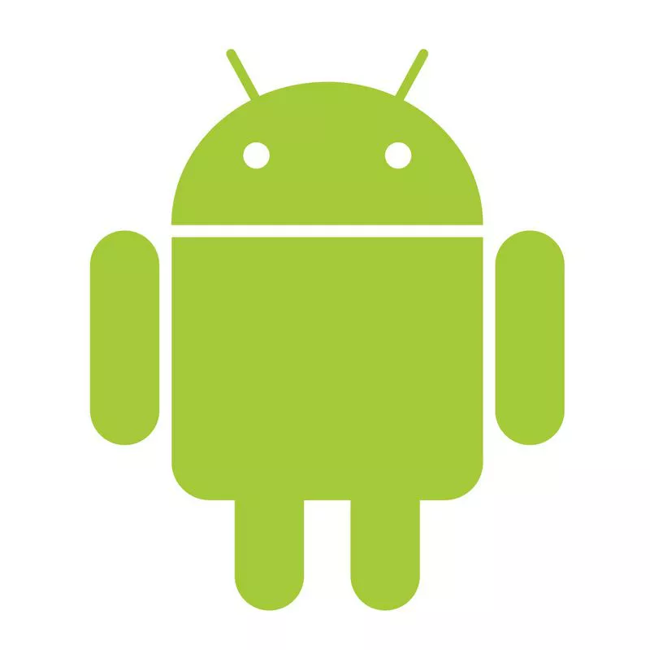

Slide 16
So why would anyone want to use it?
Zero power transmission
Less battery usage, when compared with WIFI or
Bluetooth
Can work with any audio device
Very simple to plug into your phone
Hide data inside an audio file
Broadcast data as a music file. Imagine what happens if a radio station does that
Hook up your Arduino and control robots

Slide 17
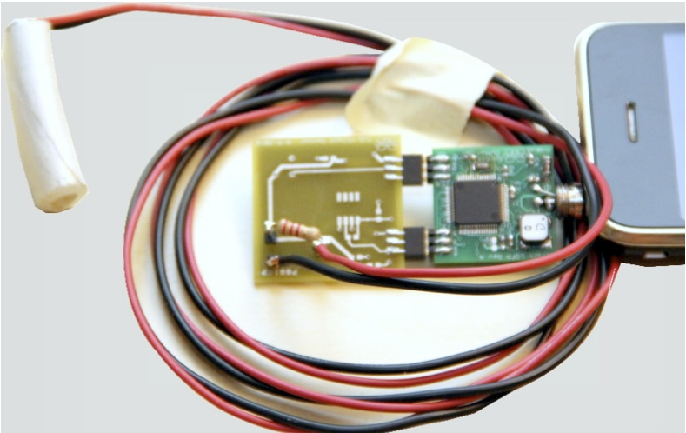
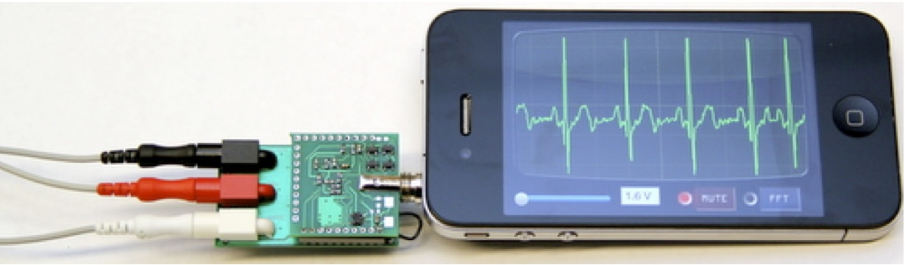
PRACTICAL USES
EKG monitor
Oscilloscope
Mobile Health Applications
Soil-moisture Sensor
Temperature Sensor
And various agricultural purposes

Slide 18
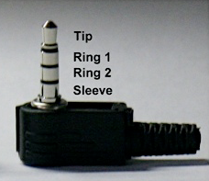
MATERIALS USED:
ARDUINO
SENSOR(s) with which we want to communicate
A TRRS CABLE (4 pole 3.5 mm Audio Jack)
An ANDROID phone (with the required app)
Basic Electronic components

Slide 20
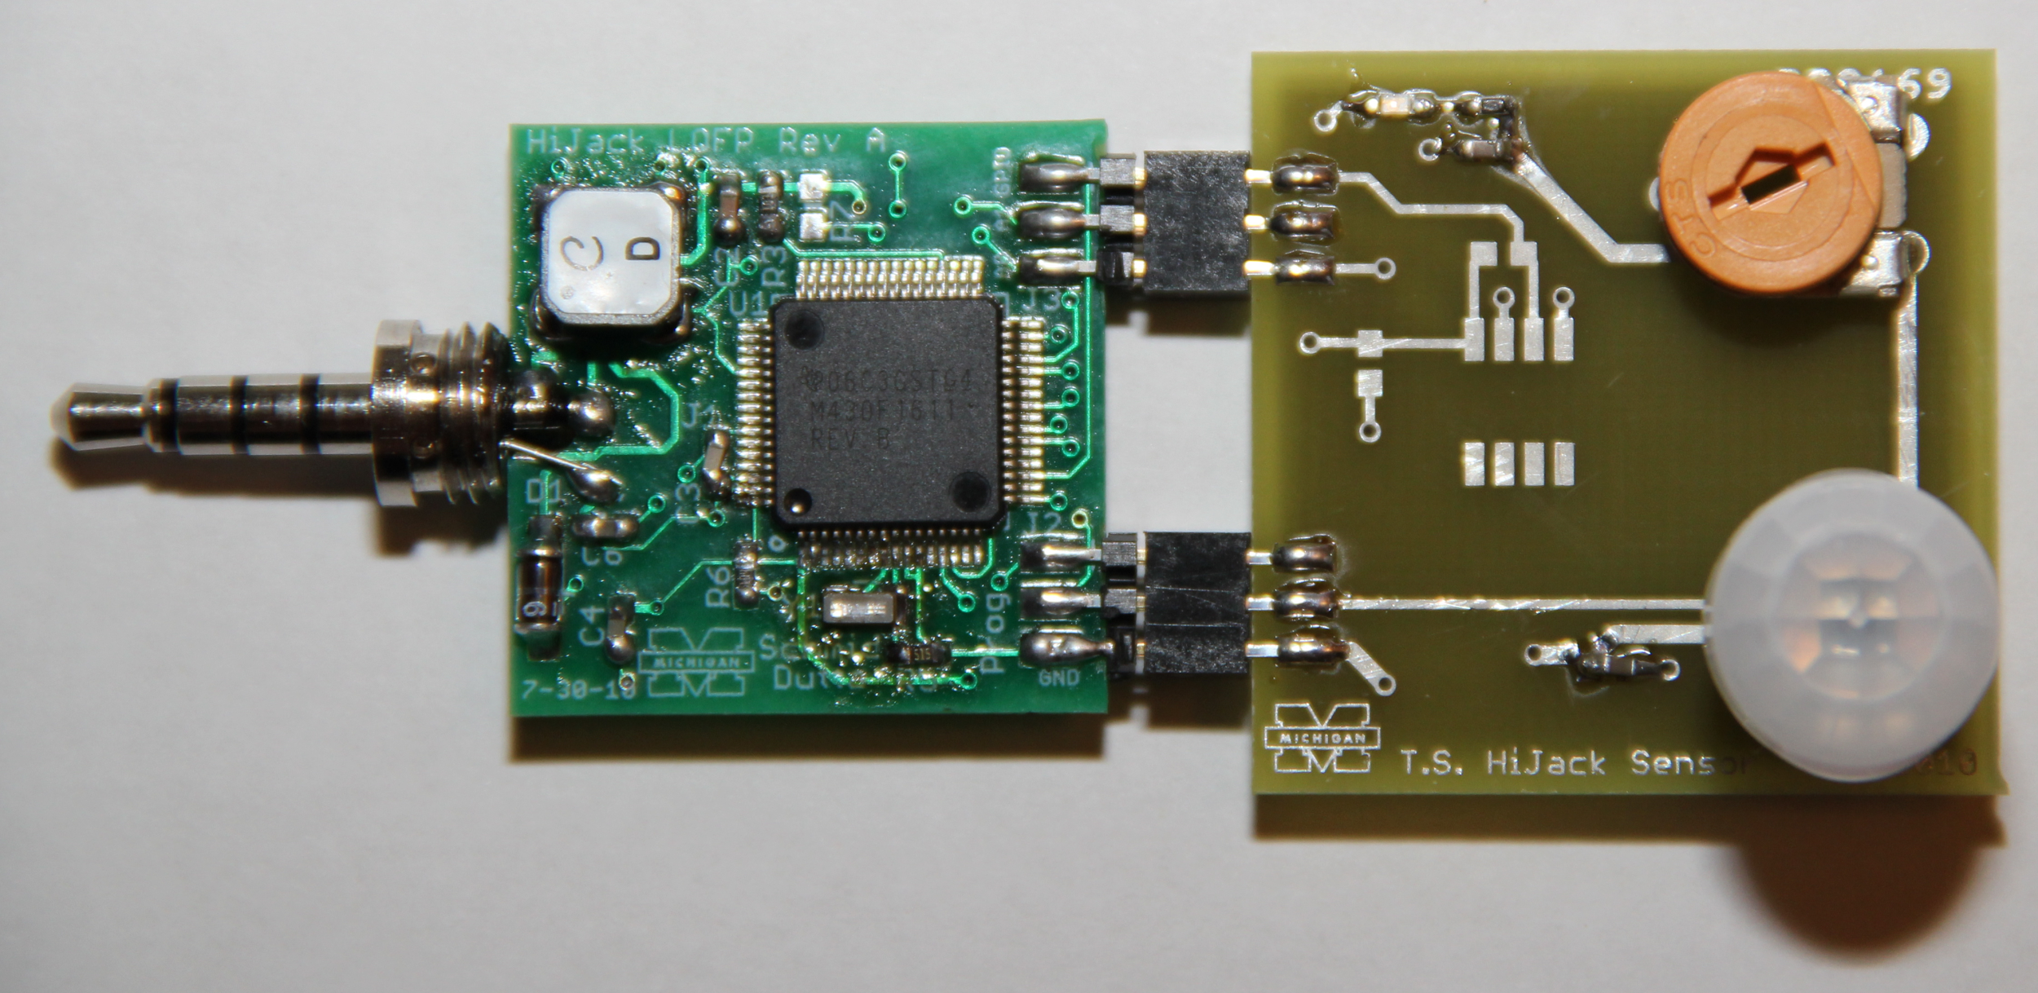
Work plan for ‘Future’
Create a miniature version of arduino consisting of only those pins that we require and the circuit using PCB designing.
The current app only receives data from arduino. So, we can modify the app to send commands to arduino using the same process and control external devices (if any).
Design an energy harvester circuit which draws power from the phone. So, there will be no need to use any external power supply.

Slide 21
References:
http://web.eecs.umich.edu/~prabal/projects/hijack/
Source Code
http://www.squareup.com/

Slide 22
THANK YOU!

